Slide 1



SHIELD INSURANCE
Key Metrics & Insights from Power BI Dashboard

Slide 2

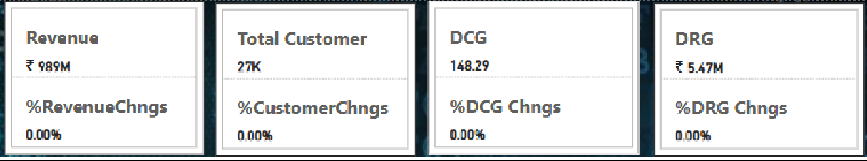
Company Overview
Shield Insurance Company provides reliable and comprehensive insurance plans for individuals and businesses, ensuring protection from various risks. Known for its commitment to customer care and security, Shield stands out in the market for its focus on coverage reliability, helping customers feel safe and secure.
Objective
Present core metrics such as total customers, total revenue, daily revenue, customer growth, and month-over-month percentage changes.
Analyze customer segmentation by age group, city, and sales mode to uncover key revenue and growth patterns.
Visualize customer and revenue trends with interactive graphs, including toggle options and filters for sales mode, age group, city, and month.
Deliver in-depth analysis of sales mode performance, customer distribution, and revenue share across age groups, cities, and sales channels.
Examine age group behavior to reveal preferences in sales modes, policy types, and
expected settlements for deeper business insights.
Key Metrics Overview
Total Revenue: ₹ 989M
Total Customers: 27K
Daily Customer Growth (DCG): 148.29
Daily Revenue Growth (DRG): ₹ 5.47M
While the current metrics reflect solid financial stability and consistent customer acquisition, the lack of growth compared to the previous period highlights an opportunity to enhance strategies for accelerated progress.

Slide 3
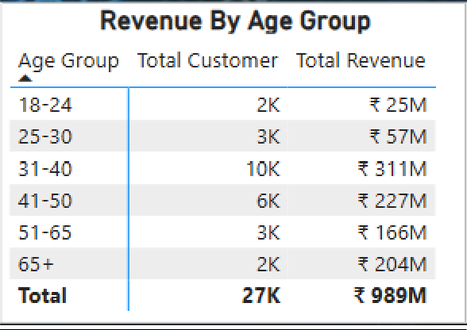
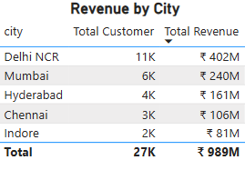
Revenue & Customer Distribution by Age Group
The 31–40 age group leads in revenue generation, contributing ₹311M from 10,460 customers.
The 41–50 age group follows with ₹227M, reflecting strong engagement from 6,031 customers.
The 65+ segment, though smaller in customer count, delivers a notable ₹204M in revenue,
highlighting its high-value potential.
City-wise Revenue & Customer Segmentation
Delhi NCR stands as the top-performing region, generating $402M from 11,007 customers,
making it the most profitable market.
Mumbai ranks second with $240M in revenue from 6,432 customers, indicating robust penetration in a key urban center.
Chennai and Hyderabad also demonstrate strong contributions with $106M and $161M respectively, underscoring the geographic diversity of revenue sources.

Slide 4
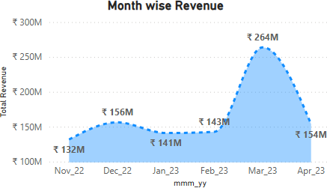
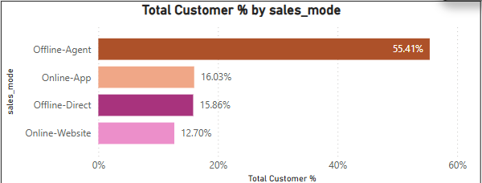
Month wise Revenue Trend
Monthly Revenue Trends: Revenue peaked at ₹264M in March 2023 before dropping to ₹143M in April, following earlier volatility with ₹141M recorded in January.
Trend Analysis: The sharp March surge—likely driven by seasonal factors—was followed by a notable decline in April, pointing to possible external market pressures or internal operational changes affecting revenue consistency.
Sales Mode Distribution
Sales Channel Breakdown: Agents drive the majority of Shield Insurance’s sales, contributing 55.41% of total volume.
Channel Insights: Other key channels include the App (16.03%), Direct (15.86%), and Website (12.70%), highlighting the continued dominance of ofline channels, with Agents and Direct collectively accounting for over 70% of sales.

Slide 5
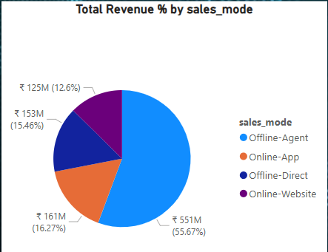
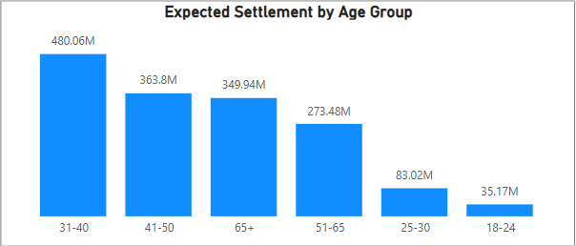
Revenue by Sales Mode
Offline-Agent Channel Leads Significantly:
The Ofline-Agent mode contributes the highest share of revenue at ₹551M (55.67%), indicating it remains the primary sales driver.
Online Channels Are Gaining Ground:
Combined, the Online-App and Online-Website channels generate ₹286M (28.87%), reflecting growing customer preference for digital platforms.
Offline-Direct Has the Smallest Share:
Ofline-Direct contributes the least at ₹125M (12.6%), suggesting it may be the least effective or
outdated mode in the current market environment.
Balanced Online Contribution:
The Online-App (₹161M) and Online-Website (₹153M) channels are nearly balanced in revenue share, showcasing diversified online user engagement across both platforms.
Expected Settlements by Age Group

Slide 6
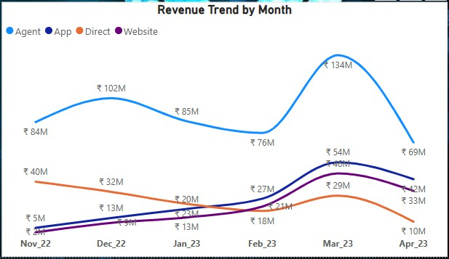
31–40 age group leads with the highest expected settlement at ₹480.06M, indicating this segment likely holds a large number of high-value policies.
41–50 follows with ₹363.8M, and 65+ closely trails at ₹349.94M, both representing significant portions of the expected payouts.
51–65 shows a moderate figure of ₹273.48M, indicating sustained policy engagement in later working years.
25–30 and 18–24 have the lowest expected settlements at ₹83.02M and ₹35.17M respectively, reflecting fewer or lower-value policies among younger individuals.
The bulk of expected settlements is concentrated in the 31–65 age range, with a peak in the 31–40 group. This suggests middle-aged customers are both highly insured and represent a critical focus for claim-related risk management.
Medium wise Monthly Trends
Agent Channel Dominates but Volatile:
Revenue through agents saw the highest performance, peaking sharply at ₹134M in March 2023 before declining to ₹69M in April — indicating a possible seasonal spike or campaign effect.
App and Website Channels Growing Consistently:
Both App and Website revenues show a steady and strong upward trajectory from Nov
2022 to April 2023, with the Website reaching ₹42M and App ₹33M in April — reflecting increasing digital adoption.

Slide 7
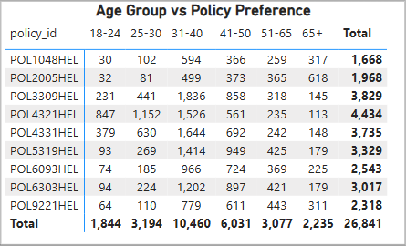
Direct Channel Shows Continuous Decline:
Revenue via the Direct channel has been steadily decreasing, dropping from ₹40M in Nov 2022 to just ₹10M in April 2023 — potentially signaling reduced effectiveness or a shift in consumer behavior.
Digital Channels Surpass Direct:
By February 2023, digital modes (App and Website) overtook Direct in revenue generation, emphasizing a significant transition towards tech-driven platforms for customer acquisition and engagement.
Policy Preference by Age Group
Most Popular Policy Overall:
POL4321HEL is the most preferred policy with 4,434 selections, indicating strong appeal across
various age groups, especially among 25–40-year-olds.
Highest Age Group Engagement:
The 31–40 age group shows the highest engagement overall with 10,460 total policies selected,
suggesting this group is the most active in purchasing health insurance.
Policy Popular Among Seniors:
POL2005HEL stands out in the 65+ age group, with 618 selections, the highest in that segment, indicating it may be tailored or attractive to older customers.
Youth Preference Skewed:
Younger customers (18–24) show strong interest in POL4321HEL and POL3309HEL, together
accounting for nearly 500 selections, hinting at entry-level or budget-friendly offerings.

Slide 8
Recommendations
Customer Growth & Revenue Stability: Leverage predictive analytics to anticipate and manage revenue fluctuations. Focus on expanding engagement among the underrepresented 18–24 and 65+ age segments to drive new growth.
Retention Strategy by Age Group: Prioritize retention initiatives for the high-value 31–40
segment through personalized offerings and targeted communication.
Regional Expansion: Replicate successful strategies from Delhi NCR in high-potential regions like Mumbai and Chennai to accelerate regional performance.
Sales Channel Enhancement: Strengthen digital platforms (App and Website) to better attract
and retain younger customers who prefer online interactions.
Risk & Policy Management: Design risk-optimized, tailored policies for high-claim segments such as the 31–40, 25–30, and 41–50 age groups to enhance profitability.
Product & Channel Alignment: Align product design and channel strategy with the preferences
of each age group to maximize engagement across all customer touchpoints.

